Slide 1
Journal Presentation
Suhas Alur S
SR Cardiology
26/03/2021

Slide 2
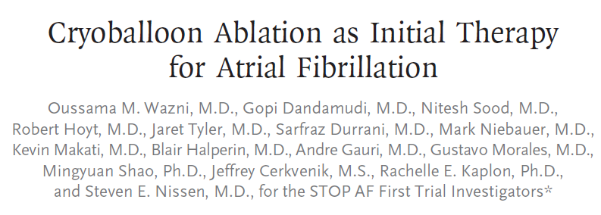


Slide 3
Introduction
In clinical practice, atrial fibrillation is the most common sustained arrhythmia encountered in adults.
Among patients in the Framingham Heart Study population, atrial fibrillation developed in 37% after the age of 55 years in those who reached that age
Atrial fibrillation is associated with an increased incidence of stroke (by a factor of approximately 4.0 in men and 5.7 in women), heart failure (by a factor of 3.0 in men and 11.0 in women), and dementia that is probably related to strokes and cerebral hypoperfusion (by a factor of 1.4 in a mixed population)
Atrial fibrillation increases the risk of death by a factor of 2.4 among men and by a factor of 3.5 among women

Slide 4
Introduction
Although the mechanisms are debated and presumably vary among patients, abnormalities of electrophysiological atrial myocytes as well as atrial structural changes, including fibrosis, probably create the electrical substrate that causes atrial fibrillation

Slide 5
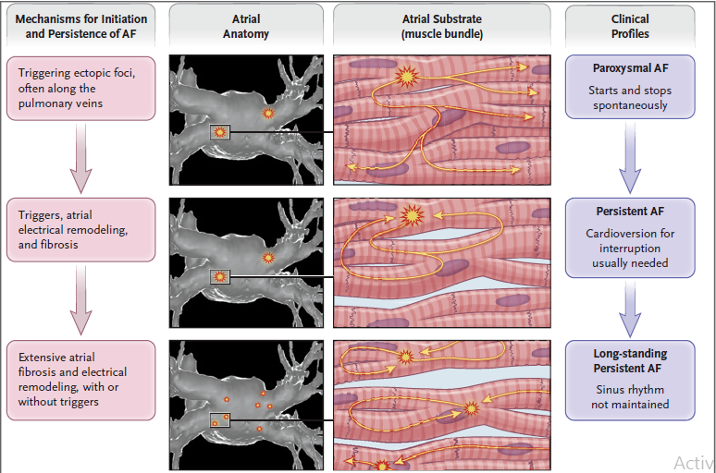
Mechanisms

Slide 6
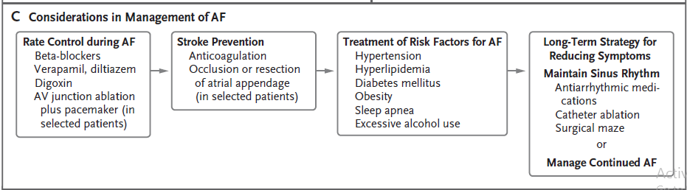
Management

Slide 7
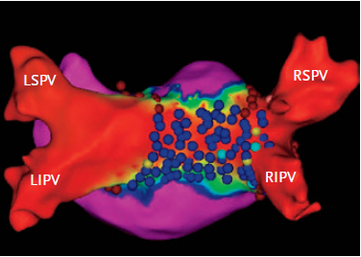
Catheter ablation
The atrial electroanatomical map from the ablation procedure. The left atrium is viewed from its posterior aspect. The blue and maroon circles denote ablation lesion sites, and red the absence of electrical signals. In areas with electrical signals, increasing signal amplitude is indicated by progression from green to blue to purple

Slide 8
Introduction
More than two thirds of patients with recently discovered atrial fibrillation have a paroxysmal pattern, but 5 to 10% per year have progression to persistent atrial fibrillation
Among patients who present with persistent atrual fibrillation and undergo a successful cardioversion, 20 % of them relapse and becomes difficult to maintain sinus rhythm
Rate vs Rhythm treatment in Atrial Fibrillation (AF) has been always a matter of debate
In patients with symptomatic paroxysmal atrial fibrillation that does not respond to drug treatment, catheter ablation is superior to antiarrhythmic drug therapy for preventing recurrence of atrial arrhythmias¹
1.Packer DL, Mark DB, Robb RA, et al. Effect of catheter ablation vs antiarrhythmic drug therapy on mortality, stroke,bleeding, and cardiac arrest among patients with atrial fibrillation: the CABANA randomized clinical trial. JAMA 2019; 321:1261-74.

Slide 9
Introduction
The large, randomized Early Treatment of Atrial Fibrillation for Stroke Prevention Trial (EAST-AFNET 4) trial compared early rhythm control (with antiarrhythmic drugs or catheter ablation) with usual care in patients who had atrial fibrillation that was diagnosed within 1 year before enrollment and other cardiovascular disease or stroke risk factors
The early rhythm-control strategy was associated with a significantly lower rate of the composite of death from cardiovascular causes, stroke, or hospitalization for heart failure or acute coronary syndrome (by 1.1 events per 100 person years; a 22% reduction), without an increase in the number of days spent in the hospital.
Serious adverse events related to treatment occurred in 4.9% of the patients in the early rhythm-control group; the most common serious adverse event in that group was drug-induced bradycardia.

Slide 10
Introduction
In the randomized Catheter Ablation vs. Antiarrhythmic Drug Therapy for Atrial Fibrillation (CABANA) trial, 57% of the patients had persistent atrial fibrillation at trial entry; after 48.5 months of follow-up, only 16% of the patients in the ablation group had persistent atrial fibrillation, as compared with 26% in the drug therapy group.
The most common procedure related adverse events were associated with vascular access (3.9% of the patients); serious complications included cardiac perforation with tamponade (0.8%), phrenic-nerve injury (0.1%), and transient ischemic attacks from cerebral emboli (0.3%).
An expert consensus statement noted that procedure-related death occurs in fewer than 1 in 1000 patients^{.1}
1)Calkins H, Hindricks G, Cappato R, et al. 2017 HRS/EHRA/ECAS/APHRS/ SOLAECE expert consensus statement on catheter and surgical ablation of atrial fibrillation: executive summary. Heart Rhythm 2017

Slide 11
Current study

Slide 12
Methods
Multicentric
Randomised 1:1 Trial (STOP AF FIRST)
Three teams involved
  Medtronic
  NAMSA research organization
  Independent team of academicians
Final content of the article were determined by academic authors

Slide 13
Methods
Inclusion criteria
  Age 18-80
  A diagnosis of symptomatic paroxysmal AF with the following documentation:
    (1) Physician’s note indicating recurrent self- terminating AF or paroxysmal AF; and
    (2) any ECG documented AF within 6 months prior to enrollment.

Slide 14
Exclusion criteria
  Previous treatment with antiarrhythmic drug for ≥7 days
  Enlarged left atrial diameter (>5 cm)
  Previous left atrial ablation or left atrial surgical procedure
  Any cardiac surgery, myocardial infarction, PCI / PTCA or coronary artery stenting which occurred during previous 90 days

Slide 15
Exclusion criteria
  NYHA class III or IV congestive heart failure and/or known left ventricular ejection fraction
  (LVEF) less than 45%
  Diagnosis of primary pulmonary hypertension
  Rheumatic heart disease

Slide 16
Methods
Cryoballoon Catheter Ablation
  Patients who were randomly assigned to the ablation group underwent pulmonary vein isolation within 30 days of randomization
  A second-generation cryoballoon (Arctic Front Advance Cardiac Cryoablation Catheter, Medtronic) was inserted with the use of a transseptal puncture
  Two cryoballoon applications, each 3 minutes in duration, were recommended for each pulmonary vein. Pulmonary vein isolation was confirmed by entrance block

Slide 17
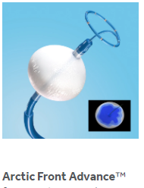
Arctic Front Advance Cardiac Cryoablation Catheter, Medtronic

Slide 18
Methods
Cryoballoon Catheter Ablation
  Treatment with class I or III antiarrythmic drugs (Exluding amiodarone) was permitted for up to 80 days after the procedure
  80 days was fixed to allow the complete washout by the end of 90 day blanking period (designed to allow procedural recovery and drug dose adjustments)
  Anticoagulation was administered for atleast 2 months

Slide 19
Methods
Drug therapy
  Treatment with class I or III antiarrythmic drug was initiated within 30 days after randomization in accordance with 2014 guidelines from ACC/AHA.
  Drug dosing and schedule changes were allowed for 90 days after initiation, after which further changes were discouraged

Slide 20
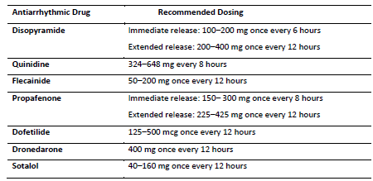
Drug therapy

Slide 21
Methods
Follow up
  In-office visits were planned at 1, 3, 6, and 12 months.
  Arrhythmia monitoring included
    12-lead electrocardiography (ECG) at each follow-up visit
    Patient-activated telephone monitoring weekly
    When symptoms developed after the blanking period
  At 6 and 12 months, 24-hour ambulatory ECG monitoring was also performed.

Slide 22
Methods
End points
The primary efficacy end point was treatment success at 12 months.
Defined as freedom from the following events:
  Initial failure of the procedure
  Any subsequent atrial fibrillation surgery or ablation in the left atrium (including those performed during the blanking period)

Slide 23
Methods
  Atrial arrhythmia recurrence
    Defined as
      Documented atrial fibrillation, atrial tachycardia, or atrial flutter for ≥30 seconds during ambulatory monitoring or for ≥10 seconds on a 12-lead ECG)
      Cardioversion
      Use of class I or III antiarrhythmic drugs (ablation group only) outside the 90-day blanking period.

Slide 24
Methods
Primary Safety End point
The primary safety end point was evaluated in the ablation group only, comprised of
  Development of a clinically significant pericardial effusion within 30 days
  Symptomatic pulmonary vein stenosis or atrial–esophageal fistula within 12 months
  Unresolved phrenic nerve injury at 12 months
  Transient ischemic attack, stroke, myocardial infarction, major vascular complication, or major bleeding within the first 7 days

Slide 25
Methods
Secondary end points
  Quality of life, which was assessed in the ablation group only (with the use of the Atrial Fibrillation Effect on Quality-of-Life [AFEQT] and European Quality of Life–5 Dimensions [EQ-5D] questionnaires, with scores compared between baseline and 12 months)
  Health care utilization, which was compared between the treatment groups.
  Other end points included serious adverse events, initial success of the procedure, and procedural characteristics

Slide 26
Statistical Analysis
Sample Size
It was assumed that 45.0% of the patients in the drug-therapy group and 69.9% of the patients in the ablation group would have treatment success and that 4.0% of the patients in the ablation group would have a primary safety end-point event within 12 months ( RAAFT-2 study and STOP AF study)
On the basis of these assumptions and an expected 10% attrition, a sample size of 210 was calculated to be sufficient to provide at least 90% power for the analysis of the primary efficacy end point and 80% power for the analysis of the primary safety end point

Slide 27
Statistical Analysis
Intention to treat analyses was done
Primary efficacy end point was evaluated with Kaplan –Meier analysis and log- rank test
Time 0 (T0) was defined as the date of ablation or initiation of drug therapy
Start date if assessing atrial arrhythmia was after 91 days following T0
The standard error for each percentage of patients with an event within 12 months was approximated with Greenwood’s formula, and two-sided 95% log–log confidence intervals were constructed.

Slide 28
Statistical Analysis
The primary safety end point was analyzed with the use of Kaplan–Meier survival analysis and was evaluated against a prespecified performance goal (upper boundary of the 95% confidence interval for the percentage of patients with a safety event, <12%) at 12 months.

Slide 29
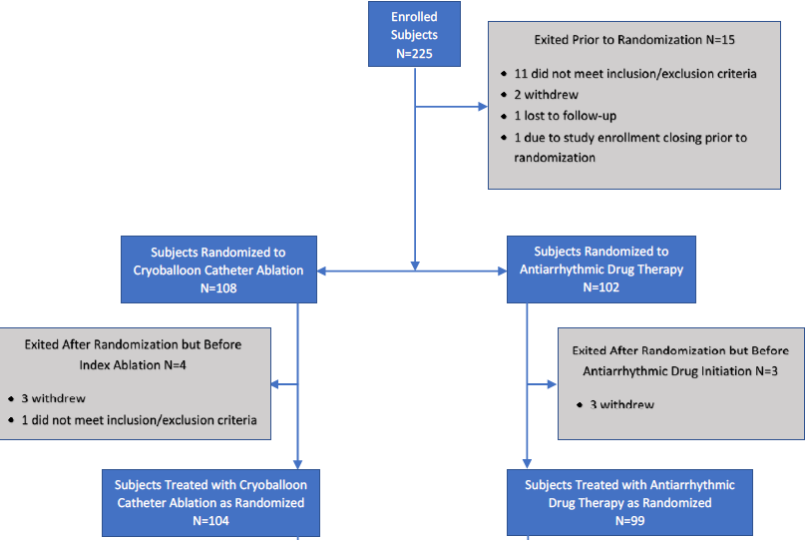
Study Enrollment

Slide 30
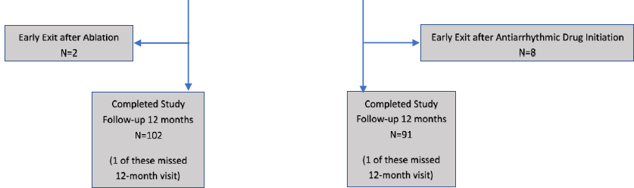
Study Enrollment conti..

Slide 31
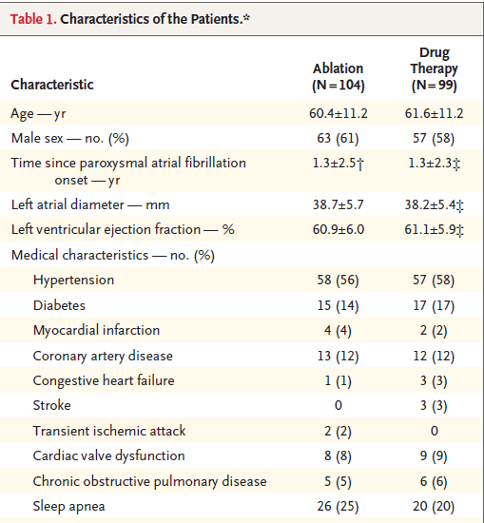
Results

Slide 32
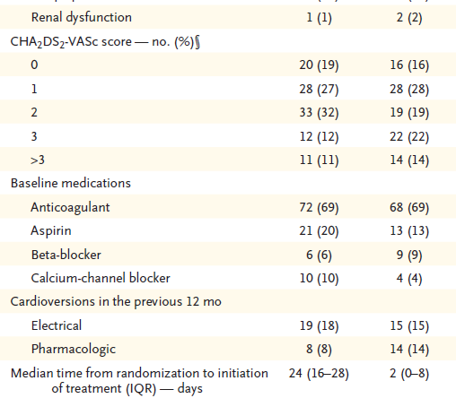
Baseline Characteristics conti..

Slide 33
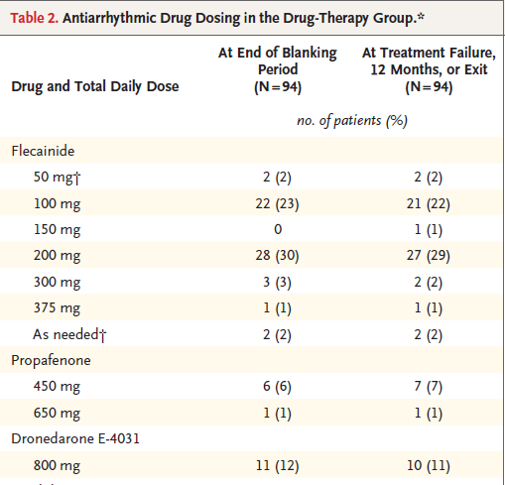
Treatment characteristics

Slide 34
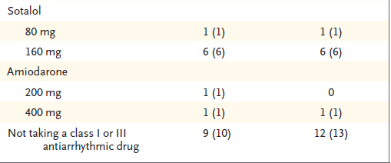
Treatment characteristics conti..

Slide 35
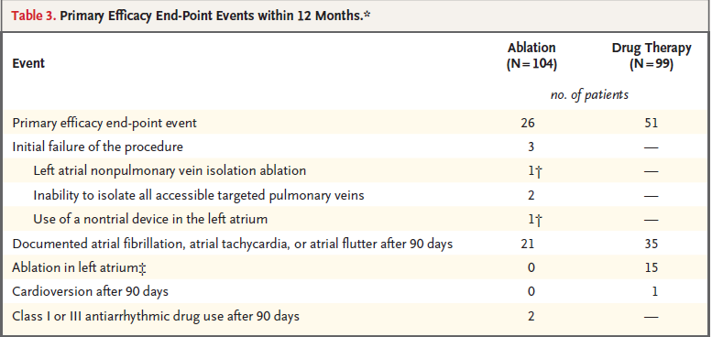
Results

Slide 36
Results
Primary Efficacy end point
The percentage of patients with treatment success at 12 months was 74.6% (95% confidence interval [CI], 65.0 to 82.0) in the ablation group and 45.0% (95% CI, 34.6 to 54.7) in the drug therapy group (P<0.001 by log-rank test)

Slide 37
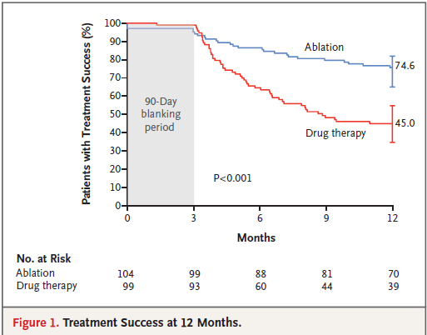
Results

Slide 38
Results
Secondary End Points
  Quality of life ablation group was assesed with both the AFEQT and the EQ-5D, was found to have improved significantly from baseline to 12 months in an analysis
  Overall 31/104 (30%) and 43/99 (44%) had cardiovascular related hospital visits
  In drug therapy group there were more emergency room visits and unscheduled visits in comparison to ablation group
  Higher rate of cardioversion in drug therapy (7%) than in ablation group (3%)
  Significant difference in cardiovascular health care utilization (69.9% vs 53.5%) and free from cardioversion (92.4% vs 97.5%) was noted between the groups

Slide 39
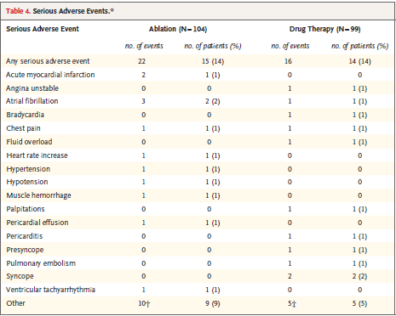
Serious Adverse Events

Slide 40
Discussion
In this randomized, multicenter trial initial use of cryoballoon ablation was superior to drug therapy in prevention of recurrence
75% of patients in cryoballoon group and 45% of patients in drug therapy group having treatment success at 12 months
A third of the patients in drug therapy group subsequently underwent ablation as a result of drug related adverse events or recurrence of arrhythmia
In this time the patients enrolled were early in the course of disease mean time from diagnosis of 1.3 years
A meta-analysis¹ compared point-by-point ablation with drug therapy and found modestly lower risk with ablation than with drug therapy
1) Proietti R, Hadjis A, AlTurki A, et al.A systematic review on the progression of paroxysmal to persistent atrial fibrillation:shedding new light on the effects of
catheter ablation. JACC Clin Electrophysiol 2015; 1: 105-15.

Slide 41
Discussion
The current guidelines suggest catheter ablation as class IIa recommendation
In this study despite having a stringent success definition 75% achieved goal in the catheter group, 15 patients in drug therapy group had drug falure
Single procedure efficacy was high compared to the previous studies ^{1,2}
1 )Holmqvist F, Kesek M, Englund A, et al. A decade of catheter ablation of cardiac arrhythmias in Sweden: ablation practices and outcomes. Eur Heart J 2019; 40: 820-30.
2). Langtved Pallisgaard J, Hilmar Gislason G, Hansen J, et al. Temporal trends in atrialfibrillation recurrence rates after ablation between 2005 and 2014: a nationwide Danish cohort study. Eur Heart J2018; 39: 442-

Slide 42
Limitations
Short follow up period
  Long term efficacy
  Long term adverse effects profile
The drug therapy was not standardized(use of either class I or class III drugs), hence might account for relative success for ablation
Intermittent monitoring might have missed the paroxysmal AF
Unblinded study, the quality of life profile of patients post ablation was better. However its attribution to the AF free state of placebo effect couldn’t be determined due to unblinded nature of study

Slide 43
Conclusion
In this randomized, multicenter trial, cryoballoon ablation was superior to antiarrythmiv drug therapy for prevention of paroxysmal AF who had not previously received rhythm control therapy
Serious procedure related side effects were uncommon

Slide 44
Take home message
Atrial fibrillation is notorious to become resistant cardioversion modality with increased duration of AF
With improved safety profile and efficacy rates of catheter ablation, balloon ablation becomes a viable option even as afirst line therapy in AF

Slide 45
Thank you

